Slide 1
Intellectual Property Rights
19EC6M02
System Partitioning
Collected by
SUMI M S
AP (ECE)
FXEC

Slide 2
Meaning and Practical Aspects of Registration of Copy Rights
Copyright, is a bundle of rights, which grants protection to the unique expression of idea
Copyright is a negative right and the owner of a copyright gets the right to prevent others from copying his work without his consent towards a commercial end.
It gives the author, an exclusive right for the commercial exploitation of his work.

Slide 3
Meaning and Practical Aspects of Registration of Copy Rights (Contd..)
Copyright in India is recognized virtually worldwide under the Berne Convention and the applicable law of its member nations.
Berne Convention, is an international agreement governing copyright, first accepted in Berne, Switzerland, in 1886
Registering your work with the Registrar of Copyright Office is basically a copyright protection insurance policy.

Slide 4
Meaning and Practical Aspects of Registration of Copy Rights (Contd..)
Copyright protection arises automatically the moment the author fixes the work in a tangible form (i.e. when a writer writes her story), without the author having to do anything.

Slide 5
Meaning and Practical Aspects of Registration of Copy Rights (Contd..)
Legal service India was designed by copyright attorneys to offer creative people complete yet affordable copyright protection services, right from the comfort of your home saving your time, energy and thousands of rupees in legal fees.

Slide 6
List of Creative Works Protected by Copyright Law in India
Literary Work which includes Computer Program and Computer Databases apart from book.
Sound Recording or Audio Recorded Files which could include Songs, Dialogues etc.
Cinematography Film includes Films, Videos, Cartoon Films.

Slide 7
List of Creative Works Protected by Copyright Law in India (Contd..)
Artistic Work Including a Painting, a Sculpture, a Drawing such as a Map, Chart or Diagram, an Engraving, a Photograph, Architecture / Artistic
Craftsmanship and Dramatic Work.
Musical Work meaning Staff Notations and Written Music.

Slide 8
Copyrights
The said work may include anything under literature, music, art, photography, cinema/film, or even a computer program, etc.
Unlike a trademark, copyright just has a single symbol, i.e., ©. The symbol can be placed on the original piece of work that has been created.

Slide 9
Who can apply for a copyright?
There is no age bar on obtaining copyright.
A minor can register one too.

Slide 10
Who can apply for a copyright? (Contd)
Three basic sets of people, who can apply for copyright are:
The creator of the work
Any person claiming to have obtained the ownership rights from the creator of the original work
An agent who has been authorized to act on behalf of the aforementioned people

Slide 11
What is Copyright Protected?
The copyright protects most of the works that are available in tangible form, including lyrics to a song, tunes, pictures, graphics, sculpture, piece of architecture, sound recordings, drama, choreographed works, parodies, and signatures.
All these must be viewed in more depth to get intricate details.

Slide 12
What is Copyright Protected?
In India, copyright can be taken for original works that fall in the area of:
Musical works,
Literary works like books and manuscripts,
Cinematography films,
Fashion designs,

Slide 13
What is Copyright Protected?
Artistic works like paintings, Performances, Software and other computer programs and compilations, etc.
However, copyright does not protect titles, names, ideas, concepts, slogans, methods, and short phrases.

Slide 14
Essential Requirements for Copyright Registration
;
Based on the Indian Copyright Act, 1957,
3 copies of the work if the work is published
If the work is not published, then 2 copies of manuscripts
If the application is being filed by an attorney, then special power of attorney signed by the attorney and the party
Authorization in respect of work, if the work is not the work of the applicant

Slide 15
Essential Requirements for Copyright Registration (Contd..)
;
Information regarding the title and language of the work
Information regarding the name, address and nationality of the applicant
Applicant must also provide his mobile number and email address
If the applicant is not the author, a document containing the name, address and nationality of the author, and if the author is deceased, date of his death

Slide 16
Essential Requirements for Copyright Registration (Contd..)
;
If the work is to be used on a product, then a no-objection certificate from the trademark office is required
If the applicant is other than the author, a no-objection certificate from the author is required
In this case, an authorization of the author may also be required

Slide 17
Essential Requirements for Copyright Registration (Contd..)
;
If a person’s photo is appearing in the work, then a no-objection certificate from such person is required
In case the publisher is not the applicant, a no-objection certificate from the publisher is required
If the work is published, the year and address of first publication is also required

Slide 18
Essential Requirements for Copyright Registration (Contd..)
Information regarding the year and country of subsequent publications
In case of copyright is for software, then source code and object code are also required.
With reference to Chapter X of the Indian Copyright Act, 1957 and Rule 70 of the Copyright Rules’ 2013, Copyright registration is made.

Slide 19
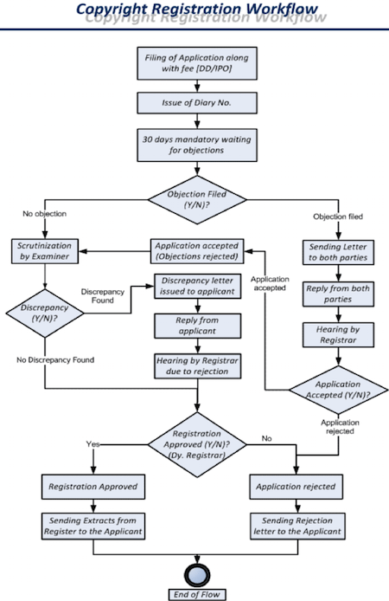

Slide 20
Registration of Trademarks

Slide 21
Trademarks
A trademark is a symbol, name, word, device or any combination which is adopted by a company to distinguish their products from the rest.
It is often referred to as brand name.
The Trade Marks Act, 1999 and Trade Marks Rules, 2002 governs the laws with respects trademarks.

Slide 22
History of Trademarks
The first official trademark law was passed in 1940.
However due to its limitations and non-use, it was replaced by the Trade and Merchandise Act, 1958.
In 1994, India became part of the TRIPS Agreements which set basic standards for intellectual property rights.

Slide 23
History of Trademarks
To meet these basic standards, a number of amendments were introduced to the trademark laws in India.
These amendments were made by replacing the former act with the Trade Marks Act, 1999 and the Trade Marks Rules, 2002.

Slide 24
Advantages of Registering a Trademark
Trademarks make it easier for your customer base to find you:
Trademarks distinguish your services and products from those of your competitors.
This identifies you as the source and indicates a consistent level of quality of your services and products.
Trademarks also increase brand awareness and goodwill.

Slide 25
Advantages of Registering a Trademark (Contd..)
Trademarks help prevent marketplace confusion:
Trademarks prevent confusion as to the source of the goods and services.
Trademarks are economically efficient tools:
Trademarks create a face value in the market among competitors. Furthermore, they give your business a monopoly over the brand name.

Slide 26
Types of Trademarks
Under the Trade Marks Act, 1999 the different types of trademarks that can be registered are:
Product Trademarks
Service Trademarks
Collective Trademarks
Certification Trademarks

Slide 27
Types of Trademarks (Contd..)
Product Trademarks: They are trademarks attached to identify the business’s products.
Service Trademarks: They are used to identify the services of the entity. For instance, the trademark for network and broadcasting service. They help advertise the service provided.

Slide 28
Types of Trademarks (Contd..)
Collective Trademarks: These trademarks are registered in the name of groups or organizations. They help people associate members with the group during commercial activities.
Certification Trademarks: They are certifying trademarks which help people judge the quality, material used, origin and other specific features of goods and services.

Slide 29
Registration of Trademarks
The registration process in India is a ‘first to file’ basis.
Therefore, it is important to apply for registration as soon as possible.
A trademark usually takes 2-3 years to get registered, if the trademark is not being opposed by a third party.
Trademark applications are handled by the Office of the Controller General of Patents, Trade Marks, Industrial Designs and Geographical Indications.

Slide 30
Registration of Trademarks (Contd..)
Branches for these offices are available in Mumbai, Kolkata, Ahmedabad, Delhi and Chennai.
The application must be filled as per territorial jurisdiction.
To register a trademark in India the following steps must be followed:-

Slide 31
Registration of Trademarks
Select a trademark agent in India:
Proprietors are only allowed to file a trademark application if their place of business is in India.
If this is not the case, the right holder must file a trademark application through an agent or attorney.
The agent or attorney usually takes care of the trivialities such as searching, preparing, filing and prosecution of the trademark.

Slide 32
Registration of Trademarks (Contd..)
Determination of the eligibility and availability of the trademark:
The agent usually starts the registration process by determining whether the trademark is eligible for registration and conducting a clearance search to see if there is a similar mark in the office of the controller general.

Slide 33
Registration of Trademarks (Contd..)
Completing the application form and filing:
If the trademark agent has the power of attorney from the right holder he can complete and file the application form. The form will require details such as name and address of the proprietor, a description of the goods and services associated with the mark, whether the mark is in use and a copy of the mark.

Slide 34
Registration of Trademarks (Contd..)
Review by the trademark office:
The trademark office reviews the application to see if it is complete and then allots the application a number.
If the trademark is registered, this number becomes the registration number.

Slide 35
Registration of Trademarks (Contd..)
Preliminary approval and publication, show cause hearing or rejection of the application:
The trademark association determines if the application is barred from registration either on absolute or relative grounds for refusal as prescribed in the Trade Marks Act, 1999.

Slide 36
Registration of Trademarks (Contd..)
After this, they issue an examination report within a period of one month.
Depending on the examination report the registrar of the trademark determines whether the application must be accepted, rejected or put up for ‘show cause’.

Slide 37
Registration of Trademarks (Contd..)
During a ‘show cause hearing’ subject to the facts an application might be rejected, accepted or accepted with certain limitations.
If the application is rejected, the applicant can appeal at the Intellectual Property Appellate.

Slide 38
Registration of Trademarks (Contd..)
Registration:
Within the term of three months publication in the Trademarks Journal, if not opposed by a third party, the trademark will proceed for registration and the trademark authority will proceed to give a registration certificate.

Slide 39
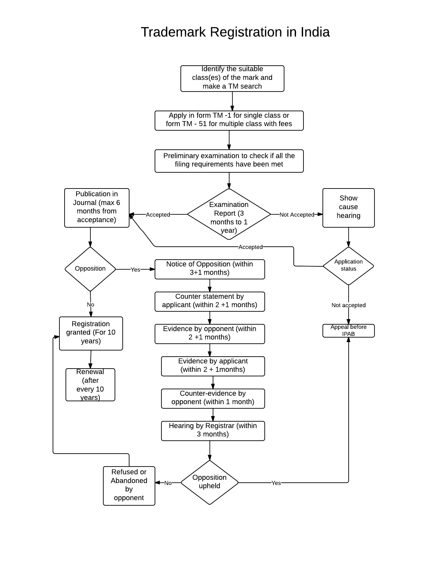

Slide 40
Trademark Registration Steps
Trademark Search
Filing Trademark Application in India
Trademark Examination
Trademark Publication
Registration Certificate
Trademark Renewal

Slide 41
Registration of Patents
The India Patent Office (IPO) grants Patent Registration in India for Inventions.
Once the Patent is registered, the Applicant gets monopoly over his/her Invention for a prescribed period of time.
The complete patent registration process involves a series of steps which are to be mandatorily followed to get a patent in India.

Slide 42
Registration of Patents (Contd..)
Applicant gets the sole right over the invention to exclude others from making, using, selling and importing the Patent.
In order to get the Patent Registration in India, a specific procedure provided in the Patents Act, 1970 and The Patents Rules, 2003 needs to be followed.

Slide 43
Registration Process
Checking the patentability of the invention by performing a search
Drafting of patent application
Filing the patent application in India
Publication of patent application
Examining of patent application
Grant of patent

Slide 44
Checking the patentability of the invention by performing a search
Before filing a patent application in India, one should perform a detailed patentability search to determine whether a patent for it will be available or not.
To conduct the patentability search the following link can be used.
http://ipindiaservices.gov.in/publicsearch
Not mandatory.

Slide 45
Drafting of Patent Application
Once the search is complete and through, the next step involved is to prepare an application form in form 1.
Each application has to be accompanied by a patent specification.
This has to be prepared in form 2.
One has to provide the complete or provisional specification depending upon the state of the invention (Whether its partially completed or completed).

Slide 46
Drafting of Patent Application (Contd..)
In case one files a provisional application, a time gap of 12 months is provided to finalize the invention and file the complete application.
A patent draft will also be required to be submitted along with the application.
The patent draft is considered a very important document as the same will be used by the patent office in deciding whether or not patent should be granted.

Slide 47
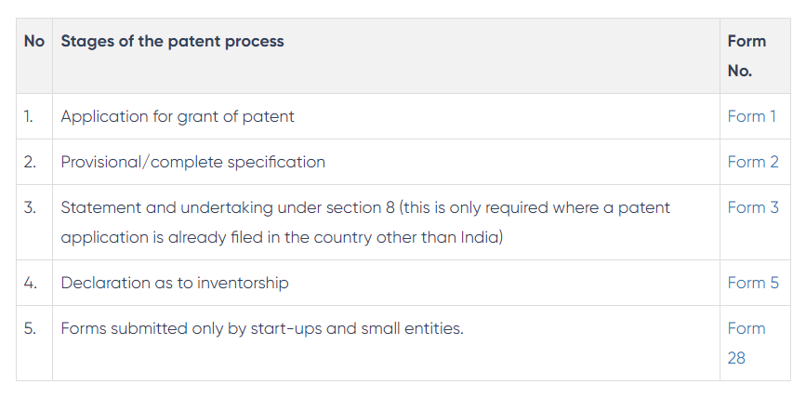
Filing the patent application in India

Slide 48
Publication of patent application
Patent application filed with the Indian patent office will be published in the official patent journal.
This is generally done after 18 months of filing the application.

Slide 49
Publication of Patent Application (Contd..)
In case one wants to get it published earlier, he can make a request in form 9 for early publication.
When a restriction is placed by the Indian patent act with regards to the publishing of the patent, the same will not be published in the journal.

Slide 50
Examining of Patent Application
Every application filed for protection will be examined before a patent is finally granted.
The application has to be made for examination in form 18.
The earlier one makes a request, the earlier the application will be examined by the examiner.

Slide 51
Examining of Patent Application
Once the application is filed, it is transferred to the patent officer who will examine the application to ensure the same is in accordance with the patent act and rules.
A thorough search is conducted by the officer where he/she analyses the relevant technology in depth and the objections, if any, will be communicated.
The report issued in this case is called the First Examination Report(FER).

Slide 52
Grant of Patent
The patent is granted once all the objections raised by the officer are resolved.

Slide 53
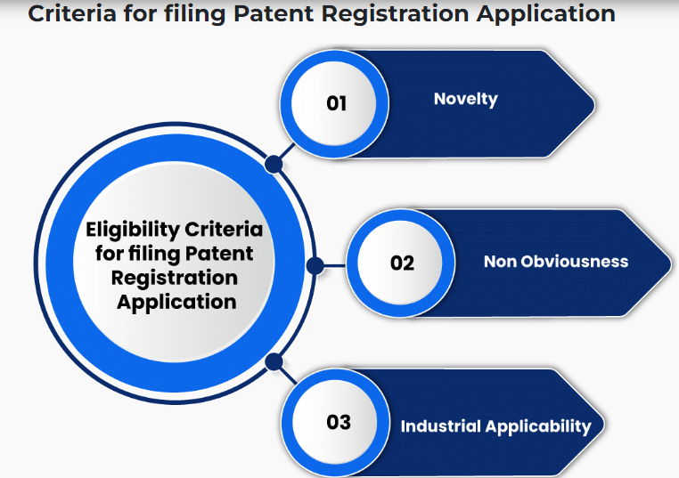

Slide 54
What is the Importance of Patent Registration?
Legal Protection to Invention: Patent Registration gives legal protection to an invention of the patentee.
In the case of patent infringement, the patentee has the right to take action and can sue for damages.
If the invention is not registered then legal protection is not enforceable.

Slide 55
Transferable Rights: Patent Registration gives the patentee a right to sell or transfer a patent as it helps in raising revenue.
Validity Period of 20 Years: After Patent Registration, an invention is legally protected for a period of 20 years.

Slide 56
Competitive Advantage: Patent Registration gives a competitive advantage to the business.
For similar products, competitors will not be able to use the patented invention.
Asset Creation: Patent is an Intellectual Property Right, therefore, Patent Registration given an exclusive right.
The patent is an intellectual asset for a business which can be sold, transferred or commercially contracted.

Slide 57
Documents for filing Patent Registration Application
For filing Patent Registration application in India, following documents are required
An Application for Patent Registration in Form-1
Complete specifications in Form-2 however if not available then Provisional Specification
Statement and Undertaking in Form-3

Slide 58
Documents for filing Patent Registration Application (Contd..)
A declaration from the inventor as to inventorship in Form 5
A proof from the inventor regarding the right to file a Patent Registration application
If a Patent Registration application is filed by the patent agent/patent attorney then the power of authority in Form-26

Slide 59
Documents for filing Patent Registration Application (Contd..)
In case of convention application (Paris convention) or PCT national phase application, one has to file priority documents along with the application or within 18 months from the priority date.
It is required to submit the National Biodiversity Authority permission in case application is related to biological material obtained from India.

Slide 60
Documents for filing Patent Registration Application (Contd..)
The source of origin of any biological material used in the specification should be clearly indicated in the Patent Registration application form.
The patent Registration application must be signed by an applicant/ Patent attorney with the name & date and Specification (Complete or Provisional) must be also be signed on the last page along with the date.

Slide 61
Forms required to be filed for Patent Registration Application
Forms to be filed | Explanation
Form 1 | Patent registration Application
Form 2 | Provisional or Complete Specification
Form 3 | Statement and Undertaking under Section 8 of The Patents Act, 1970
Form 5 | Inventorship Declaration
Form 9 | Publication Request
Form 18 | Examination Request
Form 26 | Patent Agent Authorization
Form 28 | For Small Entity

Slide 62
Validity Period of the Registered Patent in India
The patent is valid for the period of 20 years in India, from the date provisional or complete patent registration application is filed.
After completion of prescribed 20 years, it would fall under the public domain.

Slide 63
What is Patent Renewal and how one can Apply for it?
To keep the Patent alive, it has to be renewed every year.
A patent must be renewed mandatorily, in case patent is not renewed then it will be ceased to exist and it shall pass on to the public domain.
In India, a patent can be renewed for one year by filing patent renewal application along with the prescribed fees by the patentee.

Slide 64
The patent renewal fee is payable at the end of the 2nd year from the date of patent registration.
In case of non-payment of renewal fees within the prescribed time, patent gets ceased to effect then it can only be stored by filing restoration application in the prescribed Form-15 within the period of 18 months from the date patent got ceased to effect.

Slide 65
What in case of objection received from the examiner?
An examiner will issue an Examination Report to the applicant which will describe the grounds for objections.
This examination report is also known as the “First Examination Report (FER)”.

Slide 66
On receiving the First Examination Report, an applicant needs to respond to the objections.
This process may also involve appearing for hearing.
From the date FER is issued to an applicant, the patent is granted within the period of 6 months (earlier it was 12 months).

Slide 67
Registration of Geographical Indications
What is a geographical indication?
A geographical indication (GI) is a sign used on products that have a specific geographical origin and possess qualities or a reputation that are due to that origin.
In order to function as a GI, a sign must identify a product as originating in a given place.

Slide 68
The general standards of protection for Geographical Indication can be traced down to the Paris Convention for protection of Industrial Property,1883, which includes in its wide connotation, protection to- patents, trademarks, industrial designs, utility models, trade names and service mark, in addition to geographical indications.
Followed by the Madrid Agreement for repression of False or Deceptive Indications of Source of Goods 1891.

Slide 69
The Madrid Agreement concerning the International Registration of Marks signed in 1891, the Lisbon Agreement for the Protection of Appellations of Origins and their International Registration, 1958 and the Protocol Relating to the Madrid Agreement Concerning the international registration of marks, which came into being in 1989 have played important role in the development of a framework for the process of international registration of marks.

Slide 70
However, the seeds for the development of laws on Geographical Indications in India were sown through the Trade-Related Aspects of Intellectual Property Rights (TRIPS) agreement which came into force on 1st January 1995.

Slide 71
This agreement is considered to be the most comprehensive document on Intellectual Property Rights.
Post coming into force of the TRIPS agreement the Parliament of India enacted the Geographical Indication of Goods (Registration and Protection) Act, 1999.
This Act aimed at providing for the registration and better protection of geographical Indications of goods.

Slide 72
According to section 2 (e) of the Geographical Indications of Goods (Registration and Protection) Act,1999,
Geographical Indication in relation to goods means “an indication which identifies such goods as agricultural goods, natural goods or manufactured goods as originating, or manufactured in territory of a country, or a region or locality in that territory, where a given quality, reputation or other characteristics of such goods is essentially attributable to its geographical origin and in case where such goods one of the activities of either the production or of processing or preparation of goods concerned takes place in such territory, region or locality as the case may be”

Slide 73
India registered over 361 Geographical Indications till date.
The first GI to be registered was for Darjeeling Tea in the state of West Bengal, which was registered in the year 2004.
Handicrafts make up the largest type of goods which have been registered as GIs, followed by Agricultural products.

Slide 74
Who can file for Geographical Indications?
An application for registration of the Geographical Indication can be made by an association of persons or producers or any organisations or authority established by or under any law for time being in force; who must be representing the interest of the producers of the concerned goods; and desirous of registering a geographical indication in relation to such goods.”

Slide 75
Authorised User
An authorised user is a person who has been registered as such under Section 17 of the Geographical Indications of Goods (Registration and Protection) Act,1999 act.
A producer of the goods in respect of which geographical indication has been registered is eligible to register himself as an authorised user.

Slide 76
Steps applicable for registration as authorised user are-
Filing of an application
Preliminary Scrutiny and exam
Issue of Show cause notice
Advertisement
Opposition for registration
Registration

Slide 77
Prohibition on registration of certain Geographical Indications (Section 9)
There are certain Geographical Indications, the registration of which is prohibited by law. These include such indications:
The use of which is likely to deceive or cause confusion
The use of which is contrary to the law for time being in force

Slide 78
Which comprises of or contains any scandalous or obscene matter
Which comprises or contains any matter that is likely to hurt the religious sentiments of any class or section of people
Which would be disentitled to protection of law

Slide 79
Which are determined to be the generic names or indications of goods and therefore ceased or not protected in the country of origin
Which, although literary true as to the territory, region or the locality in which the goods have originated, but falsely represent that the goods originate in a different territory or locality or region of a country

Slide 80
Step by step procedure for registration of Geographical Indication
Filing of the Application
Preliminary Scrutiny and Examination
Issue of Show Cause Notice
Advertisement
Opposition to Registration
Corrections and amendments-
Registration
Duration, Renewal And Restoration
Appeal to the Appellate Boards https://blog.ipleaders.in/geographical-indication-registration/

Slide 81
Rights conferred by Registration
Under section 21 of the act, the authorised user and proprietor of the geographical indication is allowed certain rights in terms of the indication. These include:
An exclusive right to make use of the indication in relation to goods to which the indication has been obtained.
In case of infringement, to seek relief in a manner provided in the act.

Slide 82
However, it needs to be remembered that these rights conferred by registration are not absolute and are subject to conditions which restrict the powers allowed to the user, including:
Variation Condition
Restraining Conditions
Blank Space condition
Limitation Condition
https://blog.ipleaders.in/geographical-indication-registration/

Slide 83
References
[1] Prabhat Pandey, Meenu Pandey, “Meaning and Practical Aspects of Registration of Copyrights in India”, International Journal of Information Library and Society, Vol. 9, No. 1, 2020.
[2] https://blog.ipleaders.in/geographical-indication-registration/

Slide 84

ThankYou!

